Slide 1

The Unwavering Collateral Source Rule
Clarissa Collier, Esq.
Notes:
Why do we care?

Slide 2
THE RULE IN COLORADO

Slide 3
GENERAL RULE
“Compensation or indemnity received by an injured party from a collateral source, wholly independent of the wrongdoer and to which [the wrongdoer] has not contributed, will not diminish the damages otherwise recoverable from the wrongdoer.” Colo. Permanente Med. Grp., P.C. v. Evans, 926 P.2d 1218, 1230 (Colo.1996) (quoting Kistler v. Halsey, 173 Colo. 540, 545, 481 P.2d 722, 724 (1971)).

Slide 4
what is a “collateral source”?
A collateral source is “a person or company, wholly independent of an alleged tortfeasor, that compensates an injured party for that person’s injury.” 6 David R. DeMuro, Colorado Practice Series: Civil Trial Practice § 12.4, Westlaw (2d ed. Database updated Aug. 2021).
Typically an entity such as an insurance company or employer.

Slide 5
SCOPE of rule
Applies in all tort actions.
Based on premise that making injured plaintiff whole is solely the tortfeasor’s responsibility.
Third-party benefits/gifts obtained by the plaintiff accrue solely to his/her benefit.

Slide 6
SCOPE of rule
Benefits/gifts not deducted from tortfeasor’s liability.
Third-party sources are “collateral” and irrelevant in fixing liability.
Concept? Wrongdoer cannot reap the benefit of a contract for which the wrongdoer paid no compensation.

Slide 7
SCOPE OF RULE
What’s encompassed?
  Plaintiff’s health insurance benefits.
  Medicare benefits.
  Private disability benefits.
  Social security benefits.
  Retirement benefits.
Notes:
Pl’s health insurance= Volunteers of Am. Colorado Branch v. Gardenswartz, 242 P.3d 1080, 1083 (Colo. 2010)
Medicare= Forfar v. Wal-Mart Stores, Inc., 2018 COA 125, ¶ 1, 436 P.3d 580, 582
Disability, SSI, retirement = Pressey by & through Pressey v. Children's Hosp. Colorado, 2017 COA 28, ¶ 13, 488 P.3d 151, 156, overruled by Rudnicki v. Bianco, 2021 CO 80, ¶ 13, 501 P.3d 776

Slide 8
SCOPE OF RULE
In other words, Colorado applies a very broad collateral source rule.
Allows personal injury plaintiffs to claim the full amounts charged by their health care providers as damages.

Slide 9
HOW IT WORKS

Slide 10
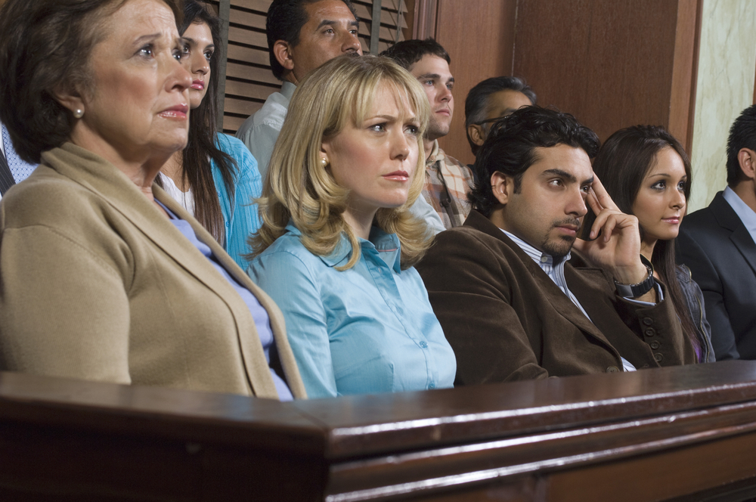
PRE-VERDICT OPERATION
Prohibits defendants from introducing at trial amounts actually paid by plaintiff’s insurer for any purpose.
Theory? Such evidence could lead fact-finder to improperly reduce plaintiff’s damages on the grounds that the plaintiff already recovered his loss from the collateral source.

Slide 11
“REASONABLE VALUE”?
CO recognizes the “reasonable value rule.”
“[T]he correct measure of damages is the necessary and reasonable value of the [medical] services rendered.” Kendall v. Hargrave, 142 Colo. 120, 123, 349 P.2d 993, 994 (1960).
To prove value, the amount paid for medical services is “some evidence of their reasonable value.” Id.

Slide 12
“REASONABLE VALUE”?
CO Supreme Court has recognized tension between pre-verdict component of rule and the “reasonable value rule.”
So what happens if evidence of amount paid discloses collateral source?

Slide 13
“REASONABLE VALUE”?
Collateral source rule will prevail.
CO Supreme Court resolved tension by holding that “the pre-verdict evidentiary component of the collateral source rule prevails in collateral source cases to bar the admission of the amounts paid for medical services.” Wal-Mart Stores, Inc. v. Crossgrove, 2012 CO 31, ¶ 20, 276 P.3d 562.

Slide 14
“REASONABLE VALUE”?
The Court in Crossgrove, explained:
“Admitting amounts paid evidence for any purpose, including the purpose of determining reasonable value, in a collateral source case carries with it an unjustifiable risk that the jury will infer the existence of a collateral source—most commonly an insurer—from the evidence, and thereby improperly diminish the plaintiff's damages award.” Wal-Mart Stores, Inc. v. Crossgrove, 2012 CO 31, ¶ 20, 276 P.3d 562.

Slide 15
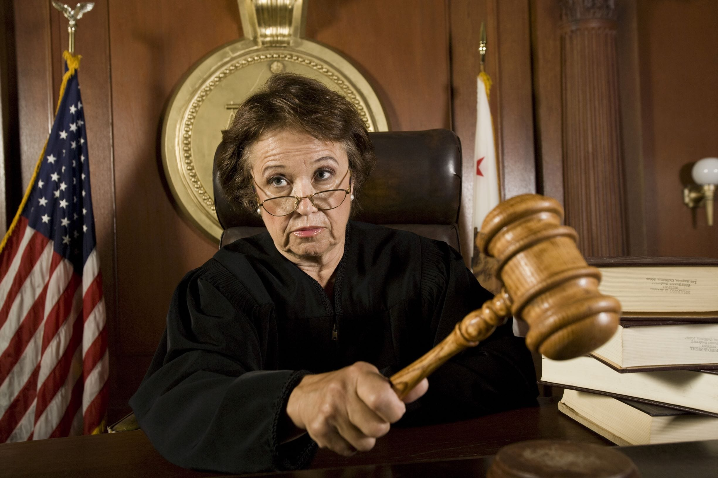
POST-VERDICT OPERATION
C.R.S. § 13-21-111.6
Requires the trial court to reduce a successful plaintiff’s verdict as a matter of law by the amount the plaintiff “has been or will be wholly or partially indemnified or compensated for his loss by any other person, corporation, insurance company or fund in relation to the injury ... sustained.”
Notes:
In any action by any person or his legal representative to recover damages for a tort resulting in death or injury to person or property, the court, after the finder of fact has returned its verdict stating the amount of damages to be awarded, shall reduce the amount of the verdict by the amount by which such person, his estate, or his personal representative has been or will be wholly or partially indemnified or compensated for his loss by any other person, corporation, insurance company, or fund in relation to the injury, damage, or death sustained; except that the verdict shall not be reduced by the amount by which such person, his estate, or his personal representative has been or will be wholly or partially indemnified or compensated by a benefit paid as a result of a contract entered into and paid for by or on behalf of such person. The court shall enter judgment on such reduced amount.

Slide 16
POST-VERDICT OPERATION
Except!
  The statute prohibits trial courts from reducing verdict by amount of indemnification/compensation that plaintiff received/will receive from a “benefit paid as a result of a contract entered into and paid for by or on behalf of” the plaintiff (i.e., the “contract exception”). See C.R.S. § 13-21-111.6
This means there is no post-trial offset for payments made by a plaintiff’s private health insurer, employment benefits, etc.
Notes:
Well that sounds nice….except! ….

Slide 17
POST-VERDICT OPERATION
Contract exception intended to “prevent a windfall to a tortfeasor when a plaintiff receive[s] benefits arising out of the plaintiff’s contract.” Volunteers of Am. Colo. Branch v. Gardenswartz, 242 P.3d 1080, 1085 (Colo. 2010).
Premise? There will rarely be double recovery because injured plaintiff will have to pay back insurers/providers.
Reality? Often triple or quadruple recover—oftentimes more than what is allowed in punitive damages!
Notes:
Well that sounds nice….except! ….

Slide 18
POST-VERDICT OPERATION
So what can reduce judgment?
  Friend/family member paid the medical bills;
  Gratuitous medical care, including Medicaid payments; and
  Under Health Care Availability Act (which only applies in med mal cases), post-verdict reduction may occur by the amount of collateral source which then may go to the insurance company. C.R.S. § 13-64-402

Slide 19
POST-VERDICT OPERATION
Even under HCAA, that’s not always what happens….
Notes:
For example, here’s some advice that I found from one of our friends in the Plaintiff’s bar’s website. The article was “3 Facts About Medical Malpractice Claims We Bet you Didn’t Know” and take a look at the second fact.
Of course, Plaintiff’s goal is to get their entire judgment—insurance be damned!

Slide 20

Double recovery? OK
Recovery of “written-off” bills? OK
Recovery of “discounted” bills? OK
Notes:
Double recovery=ok. See Volunteers of Am. Colorado Branch v. Gardenswartz, 242 P.3d 1080, 1083 (Colo. 2010)
Written off or disounted=ok. Volunteers of Am. Colo. Branch v. Gardenswartz, 242 P.3d 1080, 1088 (Colo. 2010) (holding write-offs to his medical bills by plaintiff's health care provider “were a direct result of the benefits negotiated by his health insurance company, which is a source independent of the tortfeasor)

Slide 21

Shield
Sword
Prevent tortfeasor from introducing evidence that a claimed damages has already been satisfied.
Allows plaintiff to recover fictitious amount of damages.

Slide 22

EXCEPTIONS

Slide 23

Workers’ Compensation
2021: CO Supreme Court held that collateral source rule does not apply where the workers’ compensation insurer has settled its subrogation claims against the third-party tortfeasor.
Notes:
Two cases—Delta Airlines v. Scholle and Gill v. Waltz—decided the same day in 2021.

Slide 24
Delta Airlines v. Scholle, 2021 CO 20, 484 P.3d 695, reh'g denied (May 3, 2021)
Facts
  Employee of United Airlines injured in accident with employee of Delta Airlines.
  United, which is a self-insured employer under CO’s workers’ compensation scheme, paid Scholle’s medical expenses.
  United sued Delta and its employee, asserting its subrogated right to recover the amounts it had paid.
  Scholle filed his own suit against Delta and its employee. After the two suits were consolidated, Delta settled United’s subrogated claim, which the trial court then dismissed. The trial court also dismissed Scholle’s claims against Delta’s employee

Slide 25
Delta Airlines v. Scholle, 2021 CO 20, 484 P.3d 695, reh'g denied (May 3, 2021)
Trial
  Scholle’s claims against Delta went to trial on damages only.
  Scholle had moved to preclude Delta from introducing evidence showing United had paid off his medical expenses for less than the amounts the providers had billed.
  The trial court denied Scholle’s motion. In the eventual bench trial, the trial court awarded Scholle $194,426 for economic damages, but reduced the award by the amount United had paid in workers’ compensation benefits.
  Reduction essentially eliminated Scholle’s economic damages award.

Slide 26
Delta Airlines v. Scholle, 2021 CO 20, 484 P.3d 695, reh'g denied (May 3, 2021)
CO Court of Appeals
  On appeal, a divided panel of the Colorado Court of Appeals reversed, concluding the amounts United had paid to Scholle’s medical providers should not have been introduced at trial under Colorado’s collateral source rule.
  The dissent on the Court of Appeals panel concluded Delta’s settlement of United’s subrogated claim extinguished Scholle’s claim for past medical expenses altogether, so it was unnecessary to decide the admissibility of the amounts paid on the bills.

Slide 27
Delta Airlines v. Scholle, 2021 CO 20, 484 P.3d 695, reh'g denied (May 3, 2021)
CO Supreme Court
  Held that an injured employee's claim to recover damages for past medical expenses is extinguished when the workers' compensation insurer resolves its subrogation claim with the third-party tortfeasor.

Slide 28
Gill v. Waltz, 2021 CO 21, 484 P.3d 691
Facts
  Plaintiff Joseph Gill was injured in an accident involving a truck owned by Swift Transportation Company, LLC and driven by one of its employees.
  Gill’s medical providers billed nearly $628,000 for treatment, but workers’ compensation insurer Pinnacol Assurance resolved the bills for much less.
  Pinnacol asserted and settled its subrogated claim against Swift. Gill and his spouse then sued Swift and its employee in state court.

Slide 29
Gill v. Waltz, 2021 CO 21, 484 P.3d 691
Lower court:
  The suit was removed to the U.S. District Court for the District of Colorado, where Swift filed a motion for partial summary judgment, arguing under Colorado’s workers’ compensation statute, a third-party tortfeasor’s settlement of a workers’ compensation insurer’s subrogated claim deprived the injured worker of standing to pursue the damages covered by the insurer.
  Rather than rule on the summary judgment motion, the federal trial court certified the question to the Colorado Supreme Court.

Slide 30
Gill v. Waltz, 2021 CO 21, 484 P.3d 691
CO Supreme Court:
  Decided the same day as Delta Airlines v. Scholle
  Reached same holding as Delta Airlines v. Scholle—Held that an injured employee's claim to recover damages for past medical expenses is extinguished when the workers' compensation insurer resolves its subrogation claim with the third-party tortfeasor.

Slide 31
Reasoning for CO Supreme Court’s Decisions in Schoelle and Gill
  The Court grounded its decision in the law of insurance subrogation.
  Under Colorado’s workers compensation act, a workers compensation insurer which pays benefits to or for an injured worker is subrogated to the underlying claims the worker might have against the third-party tortfeasor.

Slide 32
Reasoning for Schoelle and Gill
  The insurer can pursue a claim directly against the tortfeasor. If it does so, it stands in the shoes of the injured worker regarding the claim, and “when an insurer settles the subrogation claim, it is in fact settling the worker’s claim.
  The Court cautioned a workers compensation insurer’s settlement of its subrogated claim with the tortfeasor would not preclude pursuit of economic damages not fully covered or noneconomic damages.

Slide 33
Takeaways from Schoelle and Gill
  Scholle and Gill give defendants the means to reduce windfall and limit exposure for medical expenses.
  If workers comp paid the medical bills, defendant can attempt to eliminate plaintiff’s claim for those expenses by settling the insurer’s subrogated claim.
  Because these amounts are likely less than the full amounts billed, defendants have the possibility to eliminate claim for a fraction of what plaintiff may seek.

Slide 34

Medical Finance Company Liens
2021: CO Supreme Court held that as a matter of first impression, medical finance company's lien agreement did not confer a benefit that could qualify it as a “collateral source.”
Notes:
Shocking to hear that these grifters don’t confer a benefit
Ronquillo v. EcoClean Home Servs., Inc., 2021 CO 82, 500 P.3d 1130

Slide 35
Ronquillo v. EcoClean Home Servs., Inc., 2021 CO 82, 500 P.3d 1130
Facts
  Automobile accident victim brought action against motorist and his employer.
  Sought to recover damages for injuries incurred in the accident.

Slide 36
Ronquillo v. EcoClean Home Servs., Inc.
Lower Court:
  Motorist and employer moved to compel discovery from medial finance company pertaining to its purchase of victim’s healthcare accounts receivable.
  Finance company intervened.
  Trial court entered discovery order finding that finance company was not collateral source and motorist and employer could offer at trial evidence of amounts billed and amounts paid.

Slide 37
Ronquillo v. EcoClean Home Servs., Inc.
CO Supreme Court:
  Victim appealed.
  CO Supreme Court found it was a matter of statutory interpretation under C.R.S. § 10-1-135(10)(a), which indicates that a collateral source payment must actually indemnify/compensate injured party.
  Medical finance liens do neither. Held that medical finance company’s lien agreement did not confer a benefit that could quality if as a “collateral source.”

Slide 38

Other Recent helpful case law
Notes:
There isn’t a whole lot else—except in the medical malpractice context, Kevin Kuhn and Theresa Warden-Benz of my firm had some recent success in the case of Scholle v. Ehrics in an opinion that just came out of the Colorado Court of Appeals on July 28, 2022. Kevin is actually here with us at the conference this year and will be telling you all about that case during his presentation with Lisa Leasure, Mark Fogg, and Jim Miletech entitled “Hot Topics in Medicine.” Would encourage you to attend that presentation at 1pm in the Ziegler room to hear all about Scholle and WTO’s recent appellate win involving application of the Health-Care Availability Act.

Slide 39
PRACTICE POINTERS

Slide 40
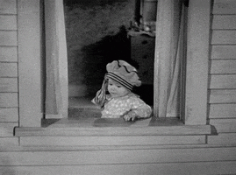
ANY WAY AROUND IT?
Try and show that the “collateral source” was not a contracted for benefit.
Notes:
Can be easier said than done—in recent med mal case, my co-counsel and I were pretty frustrated by the fact that we couldn’t get in evidence that a third party wrote off bills pre-litigation to avoid liability. To us, a plaintiff getting injured and a a third party medical provider paying the bill to avoid liability was not a “contracted for benefit” as envisioned by the collateral source rule. But the Court disagreed—but try and be creative on this

Slide 41
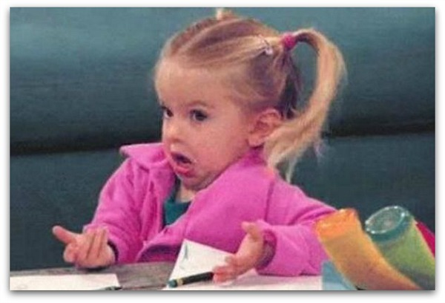
SO WHAT CAN WE DO?
Win!
Seek discovery that will undermine reasoning in case law (i.e., show that these damages have become punitive!)
Post-Verdict Practice
Push for changes in the law
Notes:
Win then you don’t have to worry about it.
Purpose of seeking discovery that will show that the rule ends with ridiculous results is to set up an appeal of the judgment.
Post-verdict practice—that can include motions practice to seek to have the judgment reduced and of course appeals.
We need to change this fraudulent law.

Slide 42
WHAT ARE OTHER JURISDICTIONS DOING?

Slide 43

Targeted collateral source rule with “Phantom Damages Reform”
“ATRA supports permitting the admissibility of evidence of collateral source payments at trial or requiring awards to be offset by the amount paid to plaintiffs by collateral sources, less the amount paid by the plaintiff to secure the benefit.”
Notes:
American Tort Reform Association—”Fighting Lawsuit Abuse Since 1986”—first national organization exclusively dedicated to reforming the civil justice system. It is a nationwide network of state-based liability reform coalitions backed by 135,000 grassroots supporters.
They have a nice little website where you can click on a map and it shows you all the current reforms. Unfortunately for us the latest reform ATRA got passed in our state was 19 years ago—which considering that Colorado was on the ATRA’s most recent “watch list” for a “judicial hellhole” we probably need some more work done here.

Slide 44



Abolished or ABROGATed
Notes:
Alabama abolished back in 1987!!
Idaho and New Hampshire—still exists, but they have enacted several statutes that mandate that a tortfeasor be liable only for those damages that remain after most forms of collateral source payments take into account.

Slide 45
ROBUST EXCEPTIONS
Malingering/exaggeration of condition.
Exaggerated financial distress.
Medical malpractice cases.
Rebut Plaintiff’s testimony that he/she paid the bills.
Private insurance.
Notes:
I have a nationwide practice at WTO, so here are some of the exceptions I’ve encountered.

Slide 46
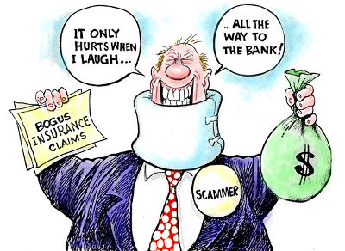
MALINGERING/EXAGGERATION
Maryland allows evidence of collateral source payments where there is evidence of malingering or exaggeration by the plaintiff. See, Leizear v. Butler, 226 Md. 171 (1961) (Plaintiff’s receipt of salary during period of disability held admissible).
Notes:
Kelch v. Mass Transit Admin. 42 Md. App. 291 (1979): “On the issue of whether the plaintiff was “dragging his feet” about returning to work, the defense can introduce evidence that his collateral benefits .. were greater than he might have earned if he were employed.”
Shenk v. Berger, 86 Md. App. 498 (1981): Defense permitted to introduce evidence that Plaintiff was receiving sick pay which motivated him to remain off work when the defense was premised upon the theory that if plaintiff had been injured it was a slight injury and he failed to mitigate his damages.

Slide 47

EXAGGERATED FINANCIAL DISTRESS
Maryland: If a Plaintiff opens the door to collateral source by asserting a misleading level of poverty, evidence of Plaintiff's insurance coverage is admissible.
Abrishamian v Barbely, 188 Md. App. 334 (2009).

Slide 48

MEDICAL MALPRACTICE
Arizona and California: Defense can introduce evidence of collateral sources. In turn, plaintiff can offer evidence of premiums paid or that recovery from the defense is subject to a lien or that the provider of the collateral benefits has a right of reimbursement. See A.R.S. 12-565; CA Civ. Code § 3333.1.
Delaware: Awards reduced by the amount of benefits from Social Security or Medicare. 18 Del. C. § 6862.
Notes:
Of course, California is a judicial hellhole and made #1 on the ATLA’s judicial hellhole list

Slide 49
MEDICAL MALPRACTICE
Iowa: Evidence of damages for actual economic losses paid by any source other than the assets of the plaintiff or the victim’s family is admissible in medical malpractice actions. See Iowa Code Ann. § 147.136.
Maryland: Statutory scheme requires that “damages be reduced to the extent that the claimant has been or will be paid, reimbursed, or indemnified under statute, insurance, or contract for all or part of the damages assessed.” Md. Code Ann., Cts. & Jud. Proc. § 3-2A-05(h).
Notes:
MD, like CO, is on the ATLA’s “ones to watch” list for judicial hellholes

Slide 50
MEDICAL MALPRACTICE
Nevada: Provides a statutory exception that mandates the introduction of collateral source evidence. See NRS 42.021.
Rhode Island: Abrogated the common law collateral source rule in actions involving medical malpractice. See R.I. Gen. Laws § 9-19-34.1.
South Dakota: Collateral source evidence allowed if special damages alleged. See SDCL § 21-3-12.

Slide 51
MEDICAL MALPRACTICE
Tennessee: Does not allow evidence of collateral source at trial. But statute reduces the damages of a medical malpractice claim by the value received by the claimant, regardless of the source. T.C.A. § 29-26-119.
Utah: Similar rule as Tennessee. Trial courts “shall reduce the amount of the award by the total of all amounts paid to the plaintiff from all collateral sources which are available to him.” Utah Code Ann. § 78B-3-405(1)-(2) (2008).

Slide 52

REBUT PLAINTIFF’S TESTIMONY THAT HE/SHE PAID
Arkansas allows admission of collateral source evidence to rebut testimony that the plaintiff paid his or her own bills. Wal-Mart Stores, Inc. v. Kilgore, 85 Ark. App. 231, 148 S.W.3d 754 (2004).

Slide 53
PRIVATE INSURANCE exception
North Dakota expressly excepts from the definition of “collateral source” “life insurance, other death or retirement benefits, or any insurance or benefit purchased by the party recovering economic damages.”
The exceptions is intended to encourage people to secure personal insurance, reduce the size of jury verdicts and control rising insurance rates.

Slide 54

Limiting Instruction
  In those jurisdictions and cases in which collateral source evidence is admissible to show malingering, exaggeration of injury, or assertion of a misleading level of poverty, there must be a limiting instruction to the jury on the relevance of that evidence.

Slide 55

TAKEAWAYS
The collateral source rule is alive and well.
No indication of change in near future.
Win and be creative!
Notes:
Questions or war stories???

Slide 56



